Slide 1
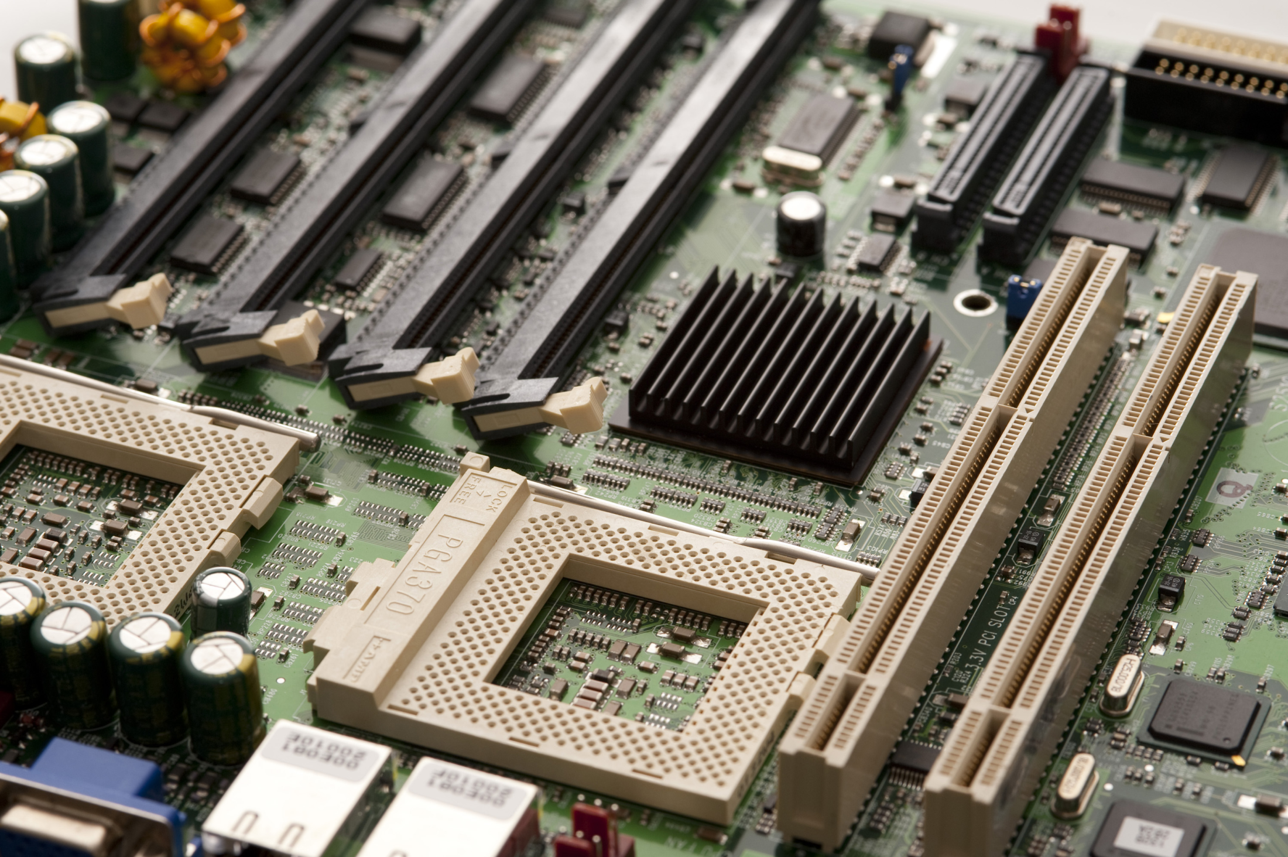
SC1006
Computer Organization and Architecture
Computer Arithmetic - Questions

Slide 2
0x20-0x2 = ?
32
2
0x18
0x12
0x1E
0x30
30

Slide 3
Which is the correct procedure to convert a positive number to a negative number in 2’s complement system?
Invert number, ignore carry bit, add one to LSB
Add one to MSB, ignore carry bit, invert number.
Invert number, add one to LSB, ignore carry bit.
Invert number, add one to MSB, ignore carry bit.

Slide 4
Which is the correct procedure to convert a negative number to a positive number in 2’s complement system?
Invert number, ignore carry bit, add one to LSB
Add one to MSB, ignore carry bit, invert number.
Invert number, add one to LSB, ignore carry bit.
Invert number, add one to MSB, ignore carry bit.
The process of ‘negation’ is outlined in the answer. And it applies to both cases of converting positive number to its negative equivalent, and vice versa.

Slide 5
Which of the following is/are true for carry bit? i: Carry bit is set when a ‘1’ is carried into the MSB of the result during computation ii: Carry bit is set when a ‘1’ is carried out of the MSB of the result during computation iii: Carry bit set implies error in the computation result, in a signed number system iv: Carry bit set implies the computation result is correct (no overflow condition), in an unsigned number system.
From the lecture notes, Carry Bit is set when a ‘1’ gets carried out of the MSB of the result.
Carry bit has two purpose:
For carrying information from lower order word to higher order words during multi-precision arithmetic.
To indicate that there is an error (overflow *condition*) in the result, in an unsigned number system.
Option [iv] is FALSE. Carry bit implies there is an error when in an unsigned number system.
i
ii
i, iii, iv
ii, iv

Slide 6
**Which of the following is/are true for overflow bit?
Overflow bit is set when a ‘1’ is carried into the MSB of the result during computation
To decide whether or not to set the overflow bit, the signed bit of the operands and result has to be evaluated
Overflow bit set implies that there is an error in the computation in a signed number system
Overflow condition implies there is insufficient memory to contain the result
Overflow bit is set when there is an overflow condition in the computation, in a signed number system.
An overflow condition is a situation where the result of the computation falls into the overflow region of the number representation system. This can be detected by analysing the sign bits of the result and operands.
Some effects of this condition are that the result is negative when adding two positive numbers, and result is positive when adding two negative numbers.

Slide 7
What is the 8-bit two’s complement binary representation of -3?
-11
-011
1101
1111 1101

Slide 8
Why do we only need to cater for 1 carry bit when performing multi-precision addition? Why not 2 or 3 bits?
Only one carry bit is available in the processor
Addition of 2 n-bit numbers will yield maximum (n+1) bit result.
Multiplication of 2 n-bit numbers will yield maximum (n+1) bit result.
Division of 2 n-bit numbers will yield maximum (n+1) bit result.
e.g. for an 8-bit unsigned number system, the range is 0 to 255. If you add two 8-bit number together, the latest result you will get is 255+255, i.e. the largest number multiply by 2.
In binary system, multiplying by two is equivalent to left shifting by 1 bit. This implies that the result will only have one more bit compared to the operands. Hence, only 1 bit will be carried out from the MSB of the result.

Slide 9
Which of the following statement is FALSE?
2.5 can be represented in a fixed point system.
2.5 is not an integer.
2.5 can be represented in a floating point system.
2.5 fully utilises the memory space provided in a binary numbering system with 4 integer and 4 fractional bits
[A] Fixed point number can have fractional value as well. Any bits that are to the right of the binary point will have a fractional weightage.
[C] e.g. in binary, 10.1
= 1.01*2^1 (floating point) = 2.5
[D] 2.5 represented with 4 integer and 4 fractional bits will be 0010.1000. The three trailing zeroes are not required and therefore this representation did not utilise the memory fully.

Slide 10
What is the advantage of IEEE754 floating point representation over a fixed point representation?
[A] IEEE754 single precision requires 32bit of data. This allows range of up to approximately +/- 2^128 as exponential value has 8 bits. Equivalent 32-bit fixed point number can only go up to max 2^32.
[B]Floating point computation is more complex than fixed point and typically requires special hardware such as FPU for more efficient computation.
[C] No, precision varies across the range.
[D] Precision of IEEE754 (normalised mode) near to the zero end of the range is 2^(-126), compare this with 32-bit fixed point number, if binary point is to the left of the MSB, it’ll be 2^(-32).
Larger range than fixed point number given the same data bits representation
Require less complex hardware to implement
Allow uniform precision over the entire range
Higher precision than fixed point number for small numbers, given the same data bits representation

Slide 11
Why do we need normalization of floating point numbers?
To align the radix point for ease of performing addition
To standardise the representation format to avoid synonymous representation
To standardise the exponent representation format for multiplication operation
To represent numbers very close to zero
Without normalisation, the radix point can be anywhere within the mantissa, this will create confusion and problem if different developers assume different radix point position during the design process.
Normalisation also has the effect for maximising precision as the leading zeros are removed.

Slide 12
**What is the effect of normalization?
Numbers very close to zero can be represented
Numbers very close to zero cannot be represented
Each number only has one form of representation
Each number could have multiple forms of representation
A normalised floating point binary number has a ‘1’ to the left of the binary point. So minimum value of the mantissa is ‘1’.
Which means that 1*2^(-n) is the smallest number that can be represented and a normalised number in this system can be smaller than that. Sort of imply that number very close to Zero cannot be represented.
Normalisation also has the effect for maximising precision as the leading zeros are removed.

Slide 13
What is underflow?
Insufficient data bits to fill the memory
Crossing into region closed to zero that is not representable by the number representation system used
A negative overflow
Underflow: both positive underflow
and negative underflow

Slide 14
Why is the functionality of Guard bits?
To prevent result from overflowing
To check if result has overflowed
Allows the precision of intermediate data to be preserved so as to obtain a more accurate final result.
To prevent loss of MSB of result
Having guard bits allows intermediate computation results to be stored in a more number of bits. This allows lower order bits to be preserved. This is improve the precision and accuracy of the final result.

Slide 15
Which of the following will give rise to the smallest single precision IEEE754 number (normalised mode)?
(-1)^{S} | x | (1.F)₂ | x | 2^{E - Bias}
F = 0,
E = 1111 1110
F = 000 0000 0000 0000 0000 0000,
E = 0000 0001
F = 100 0000 0000 0000 0000 0000,
E = 1111 1110
F = 0,
E = 1111 1111

Slide 16
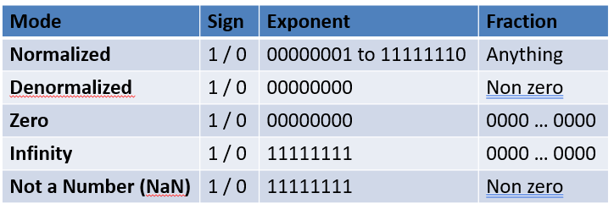
Why do we need a special representation of the value ZERO in the IEEE754 standard?
It’s special
Easier to relate Zero with a representation consisting of all 0’s
Zero cannot be represented in the format used in the normalised mode
So that computation will yield Zero regardless to the value of sign bit
Zero cannot be represented by an IEEE754 number in normalised mode.
It is represented by a special set of value, following closely of the format of the denormalised mode.

